Slide 1



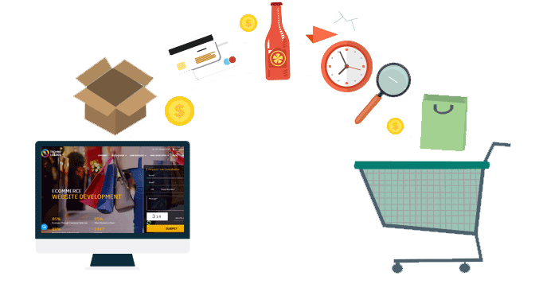

A BI Capstone project on FMCG Analytics

Slide 2

Report Analytics & Dashboard Analytics for Stake-Holders
01
Sales Dashboard
06
02
05
04
03

Slide 3
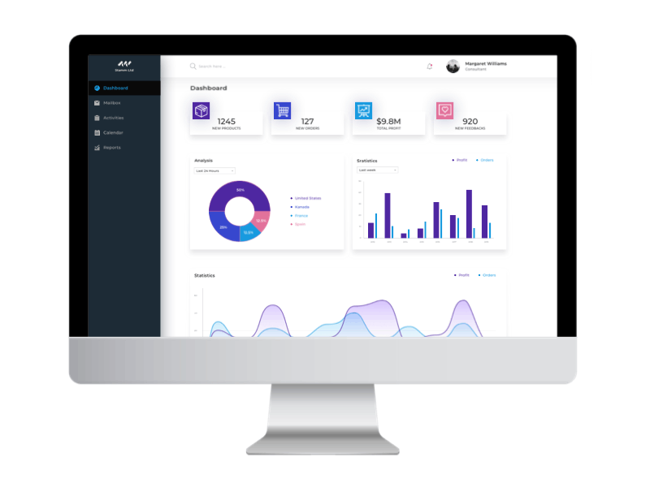
Project Steps for FMCG Data Analysis
Tools Used: Excel, Tableau, Power BI, MY SQL.
Step-by-Step Workflow:
Excel Dashboard: Create an initial dashboard using provided Excel data.
SQL Integration: Load files into a SQL database under a FMCG data schema.
BI Tool Connection: Connect SQL database to Tableau/Power BI and create a data model with necessary joins.
Dashboard Development: Build interactive dashboards in Tableau and Power BI.
Quality Assurance (QA): Validate data by comparing database records with dashboards to ensure accuracy.
Final Presentation : Create Final Presentation and Present with PPT order
1-Group Details
2-Summary about the Project
3-KPI List
4-Excel Dashboard
5-Tableau Dashboard
6-Power BI Dashboard
7-SQL Query Image
8-Key Takeaway

Slide 4
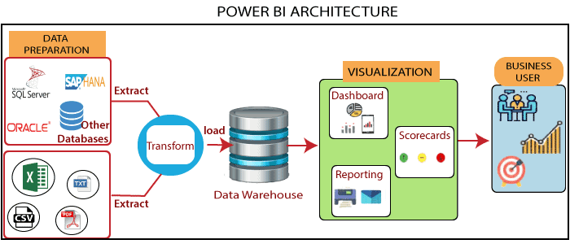

Slide 5
Report Analytics & Dashboard Analytics for Stake-Holders
FMCG Dashboard KPI
Total Sales Measures the overall revenue generated from all sales transactions within a specific period.
Store Wise Sales Tracks sales performance for each store location, helping assess individual store contributions to total revenue.
Sales Growth Evaluates the percentage increase or decrease in sales over a specific period, indicating business expansion or contraction.
Daily Sales Trend Monitors daily fluctuations in sales, identifying patterns, peak periods, and potential performance issues.
Brand Wise Sales Analyzes revenue distribution across different brands, helping assess brand performance and consumer preferences.
AM Wise Sales Breaks down sales performance by account manager, allowing evaluation of individual contributions and performance.
Sales vs Budget Compares actual sales against the projected budget to track financial performance and goal attainment.
Model Wise Sales Examines sales figures for different product models, identifying best-sellers and underperforming products.
Sales Comparison Provides a comparative analysis of sales across different time frames, regions, or categories to highlight trends and areas for improvement.
Product Wise Sales Measures sales performance of individual products, helping businesses optimize inventory and marketing strategies.
Sales by Store Category Analyzes sales based on different store categories (e.g., flagship, franchise, or online), offering insights into category-wise performance.
Sales by Meal Type Breaks down sales by meal categories (e.g., breakfast, lunch, dinner) to identify customer preferences and peak demand times.

Slide 6
Date | Time | Task Description
08-02-2025 | 09 AM – 10 AM | Project Kick-off Meeting
15-02-2025 | 09 AM – 10 PM | Implementation of KPI’s using Excel
22-02-2025 | 09 AM – 10 AM | Implementation of KPI’s using Tableau/SQL
01-03-2025 | 09 AM – 10 PM | Implementation of KPI’s using Power BI/SQL
08-03-2025 | 09 AM – 10 PM | Final Presentation of the Project

